Slide 1
Tutorial: Distributed OSGi – The ECF way
Markus Alexander Kuppe
Scott Lewis http://www.eclipse.org/ecf

Slide 2
Tutorial schedule - Agenda
13:30-13:45 | Welcome + Introduction
13:45-14:00
14:00-14:15
14:15-14:30
14:30-14:45
14:45-15:15
15:15-15:45 | Break
15:15-15:30
15:45-16:00
16:15-16:30
16:30-17:30

Slide 3
What you need
Your laptop
A working wifi connection
Traffic Sniffer (e.g. Wireshark)
http://www.wireshark.org/
Optional: Any JavaSE capable gadget (e.g. mobile phone).
  We have an iPhone that runs ECF and can be accessed during the tutorial.

Slide 4
What you need (cont.)
Eclipse SDK (with >= 3.5M6 most of the dependencies below will be included)
Equinox >= 3.5M5 (ECF requires EventHook/FindHook from OSGi R4.2)¹
http://download.eclipse.org/equinox/drops/S-3.5M5-200902021535/eclipse-equinox-3.5M5.zip
Orbit >=
EMF Runtime >= 2.4 (required for UI parts)
http://download.eclipse.org/modeling/emf/emf/downloads/drops/2.4.2/R200902171115/emf-runtime-2.4.2.zip
¹ Other OSGi implementations should work too but have not been tested. If you intent to use a different implementation than Equinox, we will try to help you get it running.

Slide 5
Distributed OSGi – The ECF way
This is not a tutorial on...
This is a tutorial on...
This tutorial is arranged as a set of modules/labs

Slide 6
What you should learn/Goals for today

Slide 7
Distributed OSGi – The ECF way
Lab1
  org.eclipse.ecf.examples.remoteservices - Create a “server” and “client” bundle and make it work with non-transparent ECF remoting
Lab2
  Explore the provider architecture and deploy whatever transport you like
  Afterwards: Show how to implement your own provider
Lab3
  Turn the non-transparent Lab1 into transparent remoting with RFC119 (get rid of boiler-plate code)
  Afterwards: Talk about transparency and its ceavats (e.g. what about errors)
    Here come parts of http://www.eclipsecon.org/2009/sessions?id=633
Lab4
  Add service discovery to get rid of static configuration through the service file
  Afterwards: Explore discovery protocols and their limitations + point out multicast limits
    If possible demo jSLP 2.0 DA functionality (depends on Jan's student)
Lab5
  Use traffic sniffer and inspect what is going on on the wire → be alarmed about no security whatsoever
Lab6
  Implement a secure network channel for r-OSGi (http://r-osgi.sourceforge.net/channels.html)
Lab7
  Extend ECF discovery UI with a custom EMF model for a specific service

Slide 8
History of distributed OSGi
Recap –

Slide 9
History of ECF

Slide 10
Who is using ECF today?
Versant Corp. for Vitness
Cloudsmith Inc. for Buckminster
Eclipse Platform includes Equinox p2 which uses ECF for all network data transfer.
IRC users on irc.freenode.net, #eclipse, #eclipse-dev, #eclipse-ecf and others use the KOS-MOS IRC bot, which was built using the ECF Bot Framework.
The EPP project includes ECF in the RCP package
The eConference project
jACT-R, a cognitive simulation system is exploring ECF for distributed model execution

Slide 11
Harvested from older presentations
All following slides come from other presentations

Slide 12
ECF Provider Architecture
Application
Eclipse, RCP, Equinox Server
3
Container Adapters
1
1
2
Datashare
Shared Editing
Call
container
Remote Services
Discovery
Datashare
File Transfer
ECF Core
Presence
Shared Object
XMPP (e.g.)‏
OSGi/Equinox
API
Provider
IAdaptable

Slide 13
Code
IContainer container = ContainerFactory.getDefault().createContainer();
IChannelContainerAdapter adapter = (IChannelContainerAdapter) container.getAdapter(IChannelContainerAdapter.class);
IChannel channel = adapter.createChannel(...)‏

Slide 14
OSGi Services
Interface
OSGi services provide
  Encapsulation at a larger granularity
  Loose coupling of functionality
  Extensibility
  Abstraction
Remote services
  Take this existing boundary to turn an application into a distributed application
  Provide an abstraction to design distributed apps
Implementation

Slide 15
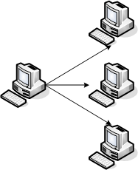
OSGi services in the network
Locate a service
  Implementation for a given interface
  Service discovery
  Common knowledge
Making use of a service
  Providing service access via ECF API
  “importing” the service into the local service registry
  Providing a local service proxy

Slide 16
ECF discovery – Requirements
Protocol and „space“ agnostic
  Does not expose protocol internals
  Not limited to, e.g., the LAN
    Namespace/ID allows flexibility in service addressing
    No strict borders to search
Transparency
  „automatic mode“
    Announcement is just a service property in the OSGi context (Extender model if 3rd party bundle)
    Listener is just a org.osgi.framework.ServiceListener
Intransparency
  „manual mode“
    Consumer gets hold of discovery services and uses it

Slide 17
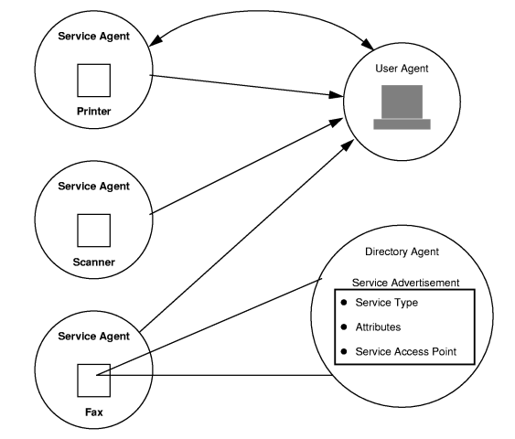
SLP Provider
SLP protocol
  Multicast discovery
  Server (DA)
Seamless transition
  DA discovery
Close(r) to OSGi
Services
  Service properties
  LDAP filters

Slide 18
mDNS Provider
DNS-SD on top of Multicast DNS
  Multicast DNS: p2p name resolution
  DNS-SD: service discovery
Idea: Hosts are authoritative for their resources
One shot and continuous queries
Well-known from Zeroconf or Apple Bonjour

Slide 19
Remote Services
OSGi services which cross address spaces
Same ideas:
  Ask for a service (-reference)
    Can trigger service discovery
  Get the service
    Get a proxy for the service
    Proxy generation can be proactive or reactive
  Use the service
    Method invocations become remote invocations
Interface
Proxy

Slide 20
Non-Transparent API
Client is aware of distribution
  Retrieve an IRemoteService object
  Explicit app-level failure handling
Explicitly call remote invocations
Call semantics can differ from local service calls
  One-shot invocation (non-blocking)
  Asynchronous invocation
    E.g., with listener callback
    Futures
Service

Slide 21

Transparent API
Service and client remain untouched
Some entity (not the client) states the demand
Proxy is already present when the client asks for the service
The service remains agnostic against distribution, as far as possible
Seamless and flexible transition from local to remote services
Interface
Proxy

Slide 22
Generic Provider
Proxy
Proxy
Proxy
DSO model
Proactive, client/server model
  In case of XMPP transport, the server is “hidden”
Connected clients see all service proxies
By default, no type injection
  the assumption is that dependant types referenced by the service interfaces are known to all peers
  Can be customized to go further
Can be used with XMPP, JMS, JavaGroups

Slide 23
R-OSGi Provider
R-OSGi was one of the first projects to enable remote OSGi services
Is itself “just a service”
Picks up services tagged for remote access
Only the interface is transmitted
Client builds a dynamic proxy
Can be added to any OSGi runtime (R3 + R4)
Protocol and transport-independent
Interface

Slide 24
R-OSGi Proxy Bundles
Synchronized lifecycle with the original bundle
  Also involves the service properties
  Changes are propagated to all proxies
Self-contained units
  Type Injection
  Provides exactly the view on the bundle that a client has when looking at the service
Interface

Slide 25


Demo
Zeroconf Discovery
HTTP
Client
running RCP App with ECF Discovery (using SLP and mDNS providers) and ECF Remote Services (using R-OSGi Provider)
Proprietary Web Cam
supports Zeroconf

Slide 26
ECF Discovery
Protocol and „space“ agnostic
  Does not expose protocol internals
  Not limited to, e.g., the LAN
    Namespace/ID allows flexibility in service addressing
    No strict borders to search
Transparency
  „automatic mode“
    Announcement is just a service property in the OSGi context (Extender model if 3rd party bundle)
    Listener is just a org.osgi.framework.ServiceListener
Intransparency
  „manual mode“
    Consumer gets hold of discovery services and uses it

Slide 27

Demo
SLP, Zeroconf Discovery
R-OSGi Remote Service
Client
running RCP App with ECF Discovery (using SLP and mDNS providers) and ECF Remote Services (using R-OSGi Provider)
iPhone
running Equinox and ECF, featuring an RemoteEnvInfo and an SMTP remote service

Slide 28
</end harvested slides>

Slide 29
Lessons learned

Slide 30
References

Slide 31
More about distributed OSGi at EclipseCon
“Real world distributed OSGi with Paremus Service Fabric” http://www.eclipsecon.org/2009/sessions?id=828
“Distributed OSGi Demo”
http://www.eclipsecon.org/2009/sessions?id=251
“Best Practices for Distributed OSGi Services” http://www.eclipsecon.org/2009/sessions?id=633
“Distributed OSGi Services”
http://www.eclipsecon.org/2009/sessions?id=757
“Distributed OSGi”
http://www.eclipsecon.org/2009/sessions?id=756
… just the ones that have “distributed” on their title

Slide 32
More information on distributed OSGi

Slide 33
Legal Notices
IBM and the IBM logo are trademarks or registered trademarks of IBM Corporation, in the United States, other countries or both.
Java and all Java-based marks, among others, are trademarks or registered trademarks of Sun Microsystems in the United States, other countries or both.
OSGi is a trademark or registered trademark of the OSGi Alliance in the United States and other countries.
Eclipse and the Eclipse logo are trademarks of Eclipse Foundation, Inc.
Other company, product and service names may be trademarks or service marks of others.

Slide 34
END
Questions or Comments?

